Slide 1





Regular Expressions (RegEx)
Advanced Text Manipulation
SoftUni Team
Technical Trainers
Software University
http://softuni.bg

Slide 2



Table of Contents
Regular Expressions
Character Classes
Operators
Quantifiers
Regular Expressions in Python
re class

Slide 3
Questions
sli.do #python-fund

Slide 4
Regular Expressions
Groups, Quantifiers, Anchors

Slide 5
Regular Expressions
Grammar to describe a search pattern
Can be used to extract data from text
[A-Z][a-z]+ [A-Z][a-z]+ - \w+@\w+\.\w+
matches
Ivan Ivanov – ivan@gmail.com
Petar Iotov – petar@abv.bg
Contact: Alex Georgiev – alex@mail.com...

Slide 6
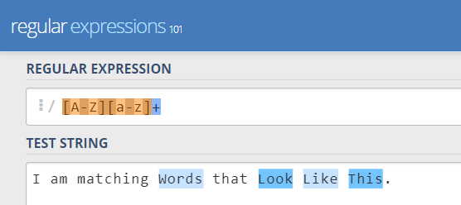
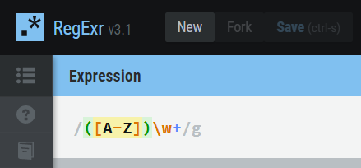
Regex Playgrounds and Resources
There are several websites for testing out regular expressions:
Regex101.com
More regex resources:
RexEgg, Python re module documentation
Regexr.com

Slide 7
Character Classes
[nvj] matches any character that is either n, v or j
[^abc] – matches any character that is not a, b or c
[0-9] - Character range: Мatches any digit frm 0 to 9
node.js v0.12.2
Abraham Lincoln
In 1519 Leonardo da Vinci died at the age of 67.

Slide 8
Character Classes (2)
\w – Matches any word character (a-z, A-Z, 0-9, _)
\W – Matches any non-word character (the opposite of \w)
\s – Matches any white-space character
\S – Matches any non-white-space character (opposite of \s)
\d – Matches any decimal digit
\D – Matches any non-decimal digit (opposite of \d)
aBcd 09_ &*^ Ю-Я
aBcd 09_ &*^ Ю-Я
Notes:
\w – Matches any word character (a-z, A-Z, 0-9, _)
\W – Matches any non-word character (the opposite of \w)
\s – Matches any white-space character
\S – Matches any non-white-space character (opposite of \s)
\d – Matches any decimal digit
\D – Matches any non-digit character (opposite of \d)

Slide 9
Quantifiers
* - Matches the previous element zero or more times
+ - Matches the previous element one or more times
? - Matches the previous element zero or one time
+359885976002
+
\+\d*
=>
+359885976002
+
\+\d+
=>
\+\d?
=>
+359885976002
+

Slide 10
Character Escapes
Sometimes you will need to look for special characters like new lines or tabulations
Then we have a new line
This is a “tab”
Name: Peter
Phone: +359882042353
We can use character escapes in our Regex:
Name:\t\w+\nPhone:\s*\+\d+

Slide 11

Anchors
^ - The match must start at the beginning of the string
$ - The match must end at the end of the string
Example – username validation pattern:
Note: Test them one by one, $ asserts the end of the string
^\w{6,12}$
jeff_butt
short
johnny
too_long_username
!lleg@l_ch@rs

Slide 12
Grouping Constructs
(subexpression) - captures the matched subexpression and assigns it a number
\num – Backreference
Match the same text that was previously matched
\d{2}-(\w{3})-\d{4}
=>
22-Jan-2015
22.Jan.2015
22-Jan-2015
Matches
\d{2}([-.])\w{3}\1\d{4}
=>
22.Jan-2015
22-Jan.2015
Does NOT match

Slide 13
Grouping Constructs (2)
(?P<name>subexpression) - Captures the matched subexpression into a named group
(?P=name) – Named backreference
Match the same text that was previously matched
\d{2}-(?P<month>\w{3})-\d{4}
=>
22-Jan-2015
22.Jan.2015
22-Jan-2015
\d{2}(?P<sep>[-.])(\w{3})(?P=sep)\d{4}
Matches
=>
22.Jan-2015
22-Jan.2015
Does NOT match

Slide 14
Grouping Constructs (2)
(?:subexpression) – Defines a non-capturing group
(?<=subexpression) – Positive lookbehind
Match only if preceded by subexpression
(?<!subexpression) – Negative lookbehind
Match only if not preceded by subexpression
^(?:Hi|hello),\s*(\w+)$
=>
Hi, Peter
(?<=#)\d{1,4}
=>
22 Gladstone #354
(?<![0-9\-])\d+
=>
Gladstone St. #-2 -123 354 2

Slide 15
Grouping Constructs (3)
(?=subexpression) – Positive lookahead
Match only if followed by subexpression
(?!subexpression) – Negative lookahead
Match only if not followed by subexpression
.*?(?=\!)
=>
This is not a drill!
\b\w+\b(?![\w?])
=>
Is this a drill?

Slide 16
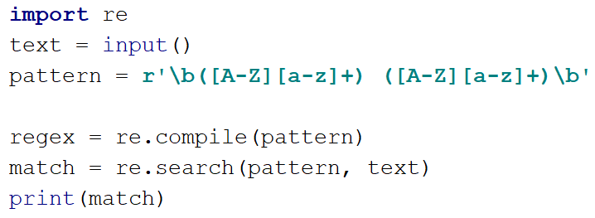
Regex in Python
Using the ‘re’ module

Slide 17
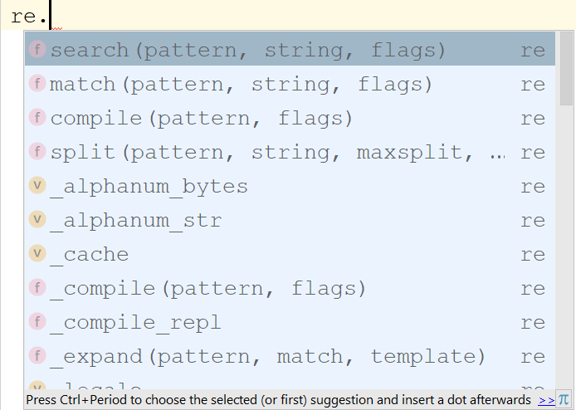
Using Regex in Python
Import the ‘re’ module, which gives us access to regex functionality
import re

Slide 18
Regex in Python: Main Functionality
re.match() – returns first match if found at string beginning
re.search() – returns first match if found anywhere in string
re.fullmatch() – returns match if entire string matches
pattern = r'\b[A-Z][a-z]+ [A-Z][a-z]+\b'
text = '1, Ivan Ivanov, ivan Ivanov, Ivan Ivanov'
re.match(pattern, text) # None
re.search(pattern, text) # match obj: Ivan Ivanov
pattern = r'name: [A-Z][a-z]+ [A-Z][a-z]+, age: \d+'
text = 'name: Ivan Ivanov, age: 28'
re.fullmatch(pattern, text) # match obj

Slide 19
Regex in Python: Main Functionality (2)
re.compile(pattern) – creates regex object
regex.findall(string) – finds all matches and returns list
regex = re.compile(r'\b[A-Z][a-z]+ [A-Z][a-z]+\b')
text = '1, Ivan Ivanov, ivan Ivanov, Ivan Ivanov'
regex.match(text) # None
regex.search(text) # match obj: Ivan Ivanov
regex = re.compile(r'\b[A-Z][a-z]+ [A-Z][a-z]+\b')
text = '1, Ivan Ivanov, ivan Ivanov, Ivan Petrov'
regex.findall(text) # ['Ivan Ivanov', 'Ivan Petrov']

Slide 20
Regex in Python: Main Functionality (3)
re.finditer(pattern, text) – creates a regex iterator
pattern = r'\b([A-Z][a-z]+) ([A-Z][a-z]+)\b'
text = '1, Ivan Ivanov, ivan Ivanov, Petur Ivanov’
for match in re.finditer(pattern, text):
print(f'Full name: {match.group()}')
print(f'First name: {match.group(1)}')
print(f'Last name: {match.group(2)}’)

Slide 21
Working with Match Objects
match.group() – Get matched text
match.start()/end() – Get start/end of match
pattern = r'\b[A-Z][a-z]+ [A-Z][a-z]+\b'
text = '1, Ivan Ivanov, ivan Ivanov, Ivan Petrov'
match = re.search(pattern, text)
print(match.group()) # Ivan Ivanov
print(match.start()) # 3
print(match.end()) # 14
print(match.span()) # (3, 14)

Slide 22
Working with Match Objects (2)
match.groupdict() – shows named groups as a dictionary
pattern = \
r'\b(?P<fName>[A-Z][a-z]+) (?P<lName>[A-Z][a-z]+)\b'
text = '1, Ivan Ivanov, ivan Ivanov, Petur Ivanov’
for match in re.finditer(pattern, text):
groups = match.groupdict()
first_name = groups['fName']
print(first_name)
“fname” named capturing group

Slide 23
Problem: Match Phone Number
You are given a sequence of phone numbers
Valid numbers start with a +359
Uses the city code 2
Has - or space as separators
Has 2 groups of digits – 3 and 4 digits long respectively
Match all of these:
Match none of these:
+359 2 222 2222
+359-2-222-2222
359-2-222-2222 +359/2/222/2222
+359-2 222 2222 +359 2-222-2222
+359-2-222-222 +359-2-222-22222

Slide 24
Solution: Match Phone Number
import re
pattern = r'\+359([ -])2\1\d{3}\1\d{4}\b'
text = input()
matches = re.finditer(pattern, text)
phones = [match.group() for match in matches]
print(*phones, sep=' ')

Slide 25
Miscellaneous Regex Functions
re.sub(pattern, repl, text) – replaces text by pattern
re.escape(string) – escapes all characters in a pattern
date = '22-Jan-2018 11.January.2018 24/March/2018'
replaced = re.sub('[-./]', '/', date)
print(replaced)
# 22/Jan/2018 11/January/2018 24/March/2018
escaped = re.escape('python.exe')
print(escaped) # python\.exe

Slide 26
Problem: Match Dates
Write a program, which matches a date
Date format: "dd{separator}MMM{separator}yyyy"
The separator will be the same on both sides
Match all of these:
Match none of these:
13/Jul/1928
10-Nov-1934
25.Dec.1937
01/Jan-1951
23/sept/1973
1/Feb/2016

Slide 27
Solution: Match Phone Number
import re
pattern = r'' # TODO: create pattern
dates = input()
matched_dates = re.finditer(pattern, dates)
for match in matched_dates:
groups = match.groupdict()
day = groups['day']
month = groups['month']
year = groups['year']
print(f'Day: {day}, Month: {month}, Year: {year}')

Slide 28

Regular Expressions
Exercises in class

Slide 29

Summary
Regular expressions describe patterns for searching through strings of text
Define special characters, operators and constructs for building complex patterns
Powerful tool for extracting specific data from text or validating strings (e.g. email/username validator)
Python provides a built-in Regex module
Supports matching, validating, splitting and replacing strings by a pattern

Slide 30






SoftUni Diamond Partners

Slide 31






SoftUni Diamond Partners

Slide 32







Regular Expressions
https://softuni.bg/courses/

Slide 33

License
This course (slides, examples, demos, videos, homework, etc.) is licensed under the "Creative Commons Attribution-NonCommercial-ShareAlike 4.0 International" license
Attribution: this work may contain portions from
"Fundamentals of Computer Programming with C#" book by Svetlin Nakov & Co. under CC-BY-SA license
Icons from http://www.flaticon.com/ (credits: Freepik, Madebyoliver)
33
Notes:
© Software University Foundation – http://softuni.org
This work is licensed under the Creative Commons Attribution-NonCommercial-ShareAlike license.
33

Slide 34




Trainings @ Software University (SoftUni)
Software University – High-Quality Education, Profession and Job for Software Developers
softuni.bg
Software University Foundation
http://softuni.foundation/
Software University @ Facebook
facebook.com/SoftwareUniversity
Software University Forums
forum.softuni.bg
Notes:
© Software University Foundation – http://softuni.org
This work is licensed under the Creative Commons Attribution-NonCommercial-ShareAlike license.
34

